Slide 1
1. Probability and Counting

Slide 2




Alice
Bob

Slide 3
Can Alice and Bob make a connection?
In uncertain situations we want a number saying how likely something is
probability

Slide 4
The cheat sheet
1. Specify all possible outcomes
2. Identify event(s) of interest
3. Assign probabilities
4. Shut up and calculate!

Slide 6
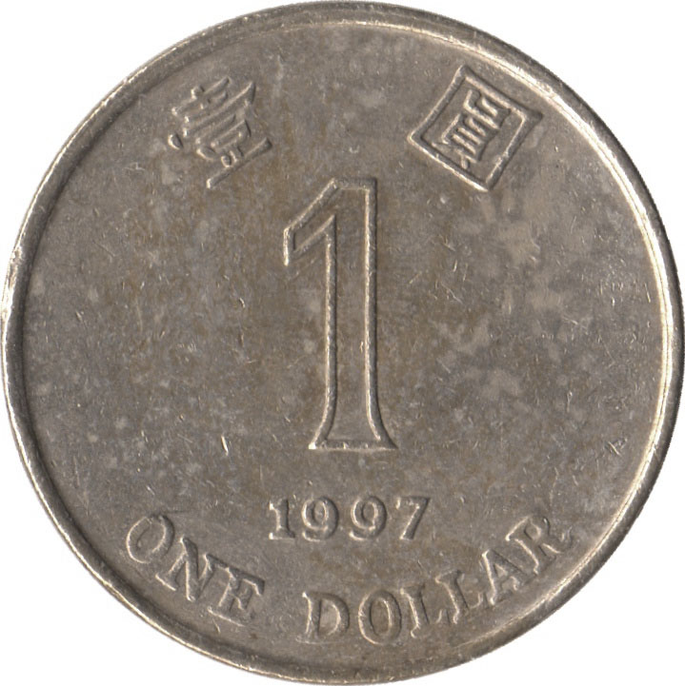
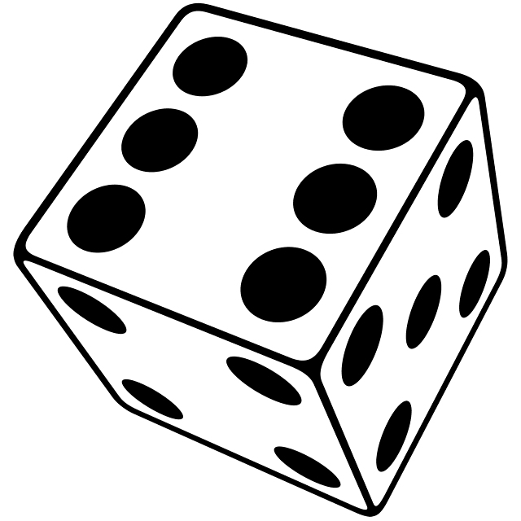
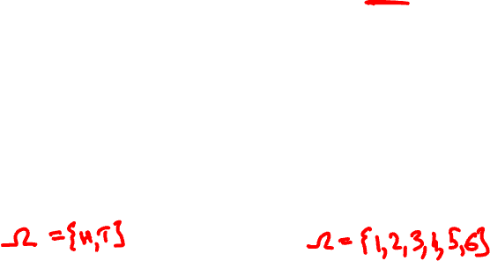
Sample spaces
The sample space is the set of
all possible outcomes.
Examples

Slide 7


Sample spaces
Ω = { HHH, HHT, HTH, HTT
THH, THT, TTH, TTT }
three coin tosses
Ω = { 11, 12, 13, 14, 15, 16,
21, 22, 23, 24, 25, 26,
31, 32, 33, 34, 35, 36,
41, 42, 43, 44, 45, 46,
51, 52, 53, 54, 55, 56,
61, 62, 63, 64, 65, 66 }
a pair of dice

Slide 8
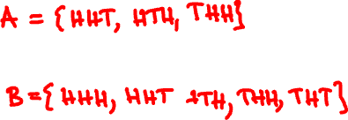
Events
An event is a subset of the sample space.
Ω = { HHH, HHT, HTH, HTT
THH, THT, TTH, TTT }
Exactly two heads:
No consecutive tails:

Slide 9
Discrete probability
A probability model is an assignment of probabilities to elements of the sample space.
Probabilities are nonnegative and add up to one.
Example: three fair coins
Ω = { HHH, HHT, HTH, HTT, THH, THT, TTH, TTT }

Slide 10

Example:

Slide 11
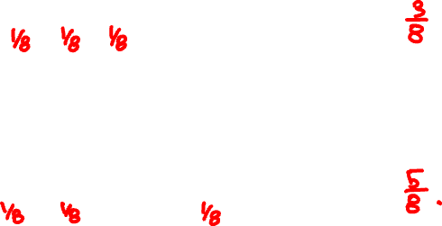
Calculating probabilities
Exactly two heads:
A ={ HHT, HTH, THH }
P(A) =
No consecutive tails:
B = { HHT, HTH, THH, THH, THT }
P(B) =

Slide 12
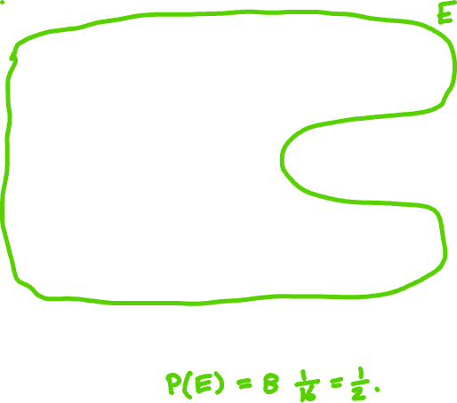

Example:

Slide 13
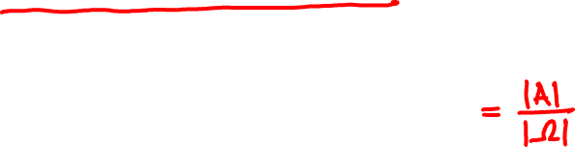
Uniform probability law
If all outcomes are equally likely, then…
number of outcomes in A
P(A) =
number of outcomes in Ω
…and probability amounts to counting.

Slide 14
Product rule for counting
Experiment 1 has n possible outcomes.
Experiment 2 has m possible outcomes.
Together there are nm possible outcomes.
Examples

Slide 15
Generalized product rule
Experiment 1 has n possible outcomes.
For each such outcome,
experiment 2 has m possible outcomes.
Together there are nm possible outcomes.

Slide 16
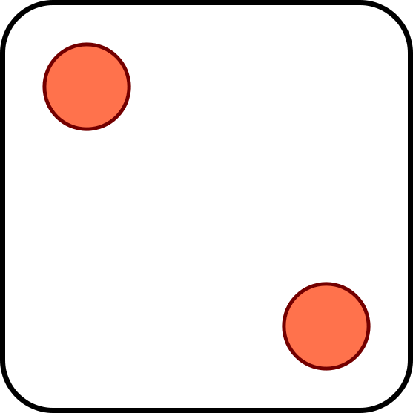
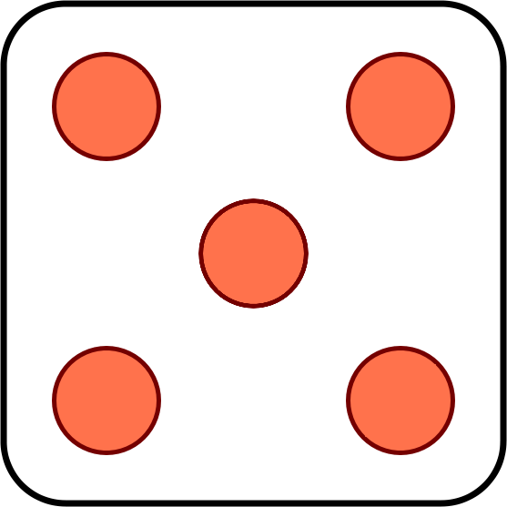
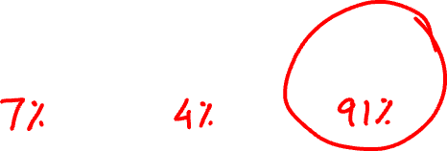
You toss two dice. How many ways are there for
the two dice to come out different?
A
B
C
15 ways
25 ways
30 ways

Slide 17
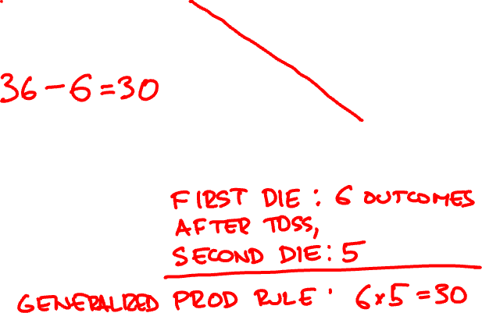
Solution 1:
11, 12, 13, 14, 15, 16,
21, 22, 23, 24, 25, 26,
31, 32, 33, 34, 35, 36,
41, 42, 43, 44, 45, 46,
51, 52, 53, 54, 55, 56,
61, 62, 63, 64, 65, 66
Solution 2:

Slide 18

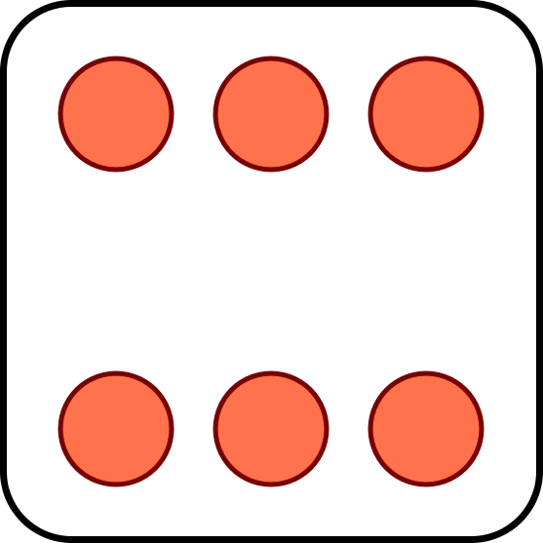
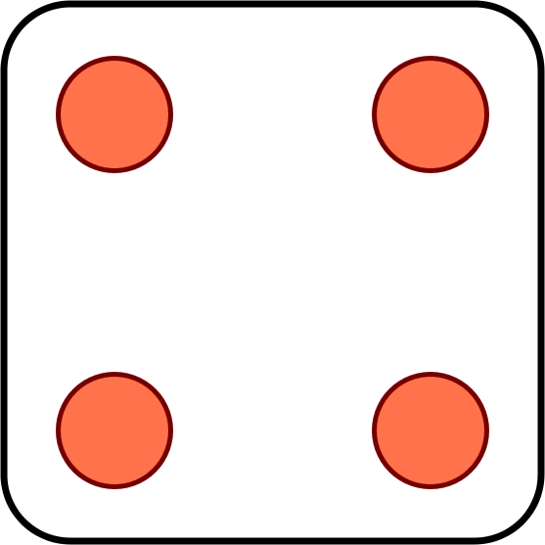
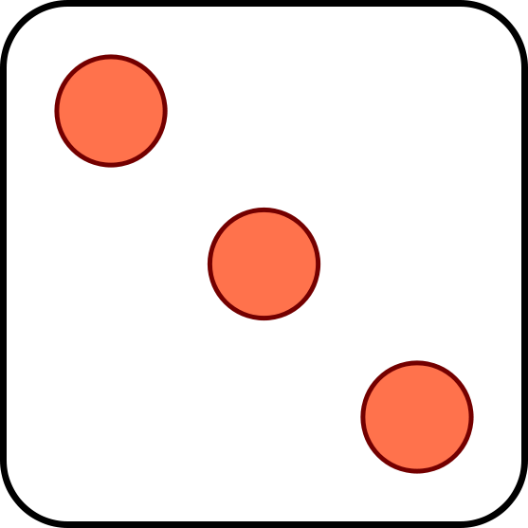
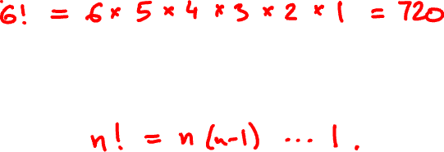
Permutations
You toss six dice. How many ways are there for all six to come out different?
The number of permutations of n different objects is

Slide 19
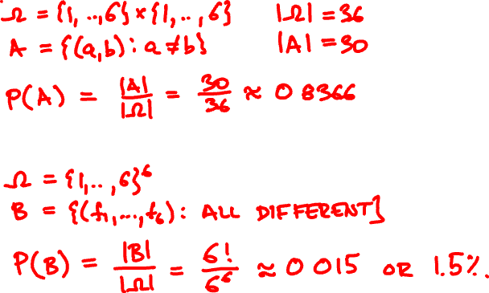
Equally likely outcomes
For two dice, the chance both come out different is
For six dice, the chance they all come out different is

Slide 20


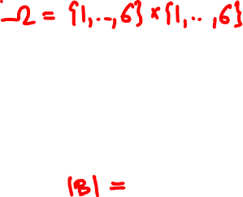

Toss two fair dice. What are the chances that…
(a) The sum is equal to 7?
(b) The sum is even?
(c) The second one is bigger?

Slide 21

11, 12, 13, 14, 15, 16,
21, 22, 23, 24, 25, 26,
31, 32, 33, 34, 35, 36,
41, 42, 43, 44, 45, 46,
51, 52, 53, 54, 55, 56,
61, 62, 63, 64, 65, 66

Slide 22


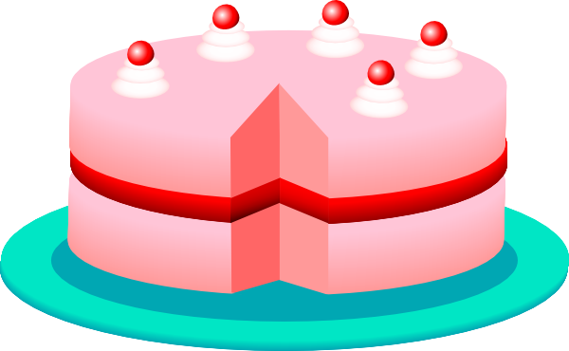
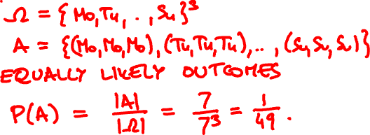
There are 3 brothers. What is the probability that
(a) All have birthdays on the same day of the week?
M T W T F S S

Slide 23
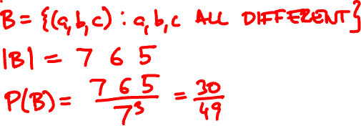
(b) All have birthdays on different days of the week?
M T W T F S S

Slide 24
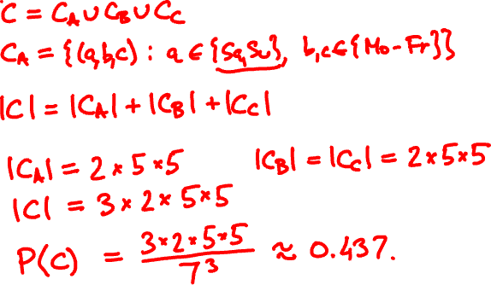
(c) Exactly one birthday is on the weekend?
M T W T F S S

Slide 25
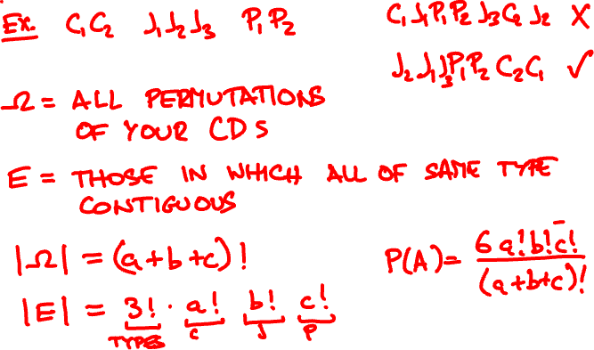
a classical, b jazz, and c pop CDs are arranged at random. What is the probability that all CDs of the same type are contiguous?

Slide 26
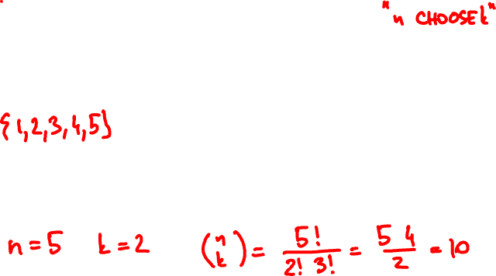

Partitions
n
n!
(
)
=
k
k! (n - k)!
is the number of size-k subsets of a size-n set

Slide 27
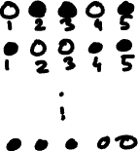
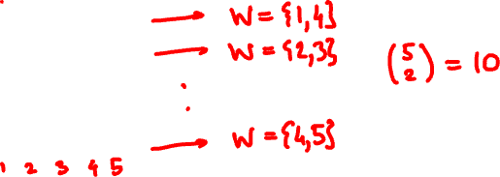
Partitions and arrangements
size-k subsets of a size-n set
n
(
)
k
arrangements of k white
and n – k black balls

Slide 28
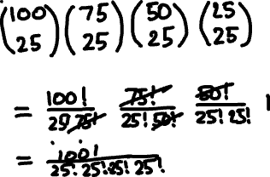


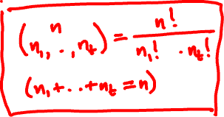
Partitions and arrangements
(
n
)
partitions of a size-n set into
t subsets of sizes n₁, …, n_{t}
n₁, …, n_{t}

Slide 29
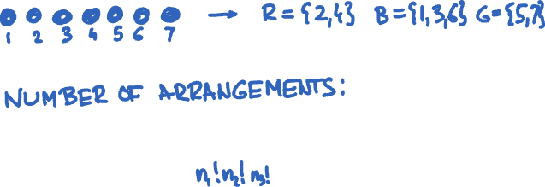

Partitions and arrangements
(
n
)
arrangements of n₁ red, n₂ blue, …, n_{t} green balls
n₁, …, n_{t}

Slide 30
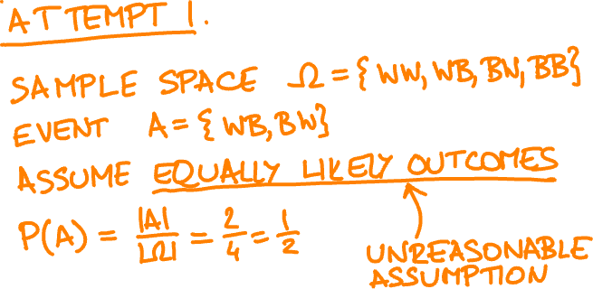
An urn has 10 white balls and 20 black balls. You draw two at random (without replacement). What is the probability that their colors are different?

Slide 31
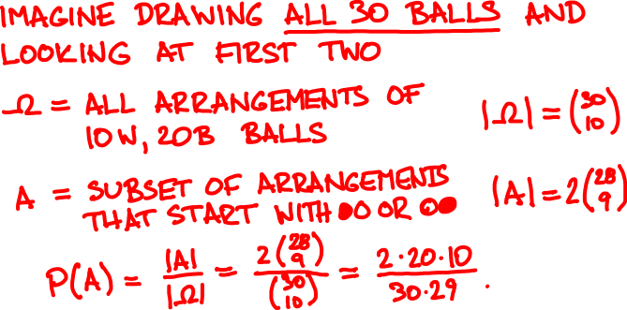
An urn has 10 white balls and 20 black balls. You draw two at random (without replacement). What is the probability that their colors are different?

